Slide 1
UP Introduced

Slide 2
Team Instructor
John Sturman
Anita Kuchera
Danny Coretti
We’re Team Instructor!
  Motto: Honey is good for the brain.

Slide 3
Analysis and Design
Analysis
  Investigation of the problem and requirements.
  Object analysis: investigation of domain objects; think in terms of NOUNS.
Design
  Software layout: think in terms of CLASSES.

Slide 4
Analyze a Game
Dealer has:
  3 upside down cups.
  A small ball, coin or poker chip.
Player puts the ball under one cup.
Dealer moves the cups around.
Player guesses which cup has the ball.
Player wins if he/she guessed correctly.

Slide 5
What is Analysis?
Define use cases:
  Tell us a story about the problem.
    “Player comes to table and … guess correctly … wins”.
    Prior slide was an informal use case.

Slide 6
What is Analysis?
Define domain model:
  The “things” mentioned in the use cases:
    Cup (3), Ball (1)
    Dealer (1), Player (1)
  Their relationships:
    Ball under Cup
    Dealer moves Cups

Slide 7
Tell Us a Story
Use Cases are stories or scenarios.
Not object-oriented!
One of the most important concepts of requirements analysis.
Basis for:
  User documentation.
  Test plans.

Slide 8
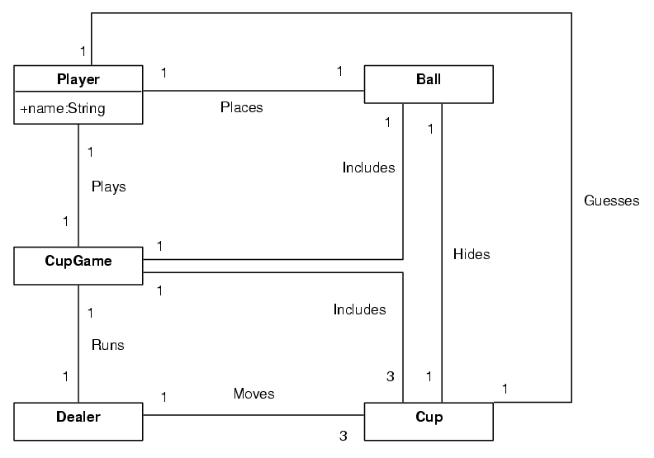
Draw Us a Picture

Slide 9
Object-Oriented Design
UML diagrams:
  Interaction – dynamic, messages, verbs.
  Class – static, capabilities, state, nouns.
Inspired by the real world.
  But not a direct copy.

Slide 10
Iterative Development
The system grows incrementally.
Each iteration:
  Requirements, Design
  Implementation, Testing
Repeat iterations many times.
Iterations are timeboxed: 2-6 weeks.

Slide 11
Iterative Development
A software development methodology.
Repeats software development disciplines, such as analysis, design, etc.
Considered state-of-the-art approach.
Good for class work, industry work, life.

Slide 12
Iterative Lifecycle
Iteration 1
Iteration 2
Requirements
Requirements
Design
feedback
Design
Implementation &
Test & Integration
& More Design
Implementation &
Test & Integration
& More Design
Final Integration &
System Test
Final Integration &
System Test
Iterations are
fixed in length,
timeboxed
Short: 2-6 weeks
System grows
incrementally with each iteration

Slide 13
Waterfall Lifecycle
Most Requirements,
Defined and Stabilized
Design
Implementation
Integration and Testing
Long lifecycle - 6 months or more!

Slide 14
Timeboxed Iterations
Time length – fixed in stone.
Features – prioritized and flexible:
  Must, Should, Could, Won’t
  Drop features rather than extend time.
Result of iteration:
  Incomplete system.
  But it is executable and testable!

Slide 15
The Unified Process (aka UP)
The Unified Process:
  Uses iterative development.
  Well-known. You are likely to be exposed to it.
Others:
  XP, Scrum, DSDM, etc.

Slide 16
UP Phases
Inception – viability of project, vision.
Elaboration – budgets, schedule, iterations.
Construction – more iterations.
  Most hard stuff is done very early.
Transition – beta testing, final deployment.

Slide 17
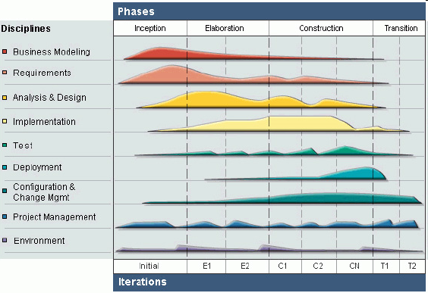
The Phases in UP
http://www.ibm.com/developerworks/webservices/library/ws-soa-term2/

Slide 18
True or False?
Inception != Requirements
Elaboration != Design
Construction != Implementation
True. UP Phases (project stages) !=
UP Disciplines (activities)

Slide 19
No waterfalls!
It may be hard to imagine that you should not develop software sequentially, in a completely preplanned manner.
Shouldn’t we be agile and adapt to change?
The worst thing I can think of is when a waterfall project becomes an ongoing mess (build and fix).

Slide 20
Unified Modeling Language
A graphical syntax: uses symbols, lines.
  “A picture is worth a thousand words.”
Describes system components:
  Organization, Interactions
Rather complex standard.
Frequently used in combination with the UP.

Slide 21
A Recipe for this Class
Use the Unified Process:
  Phases, artifacts, iterative development
Improve designs through use of patterns.
Translate designs to code.
Separate, simplify, reuse.

Slide 22
Example – Step 1:
Requirements, Use-Case Model
Use Case UC1: Play Cup Game
Primary Actor: Player, Dealer
Main Success Scenario:
  1. Player puts ball under cup
  2. Dealer moves cups
  3. Player picks cup
  a. If ball is under cup then they win…
  b. Else they lose…

Slide 23
Example - Step 2:
Domain Model

Slide 24
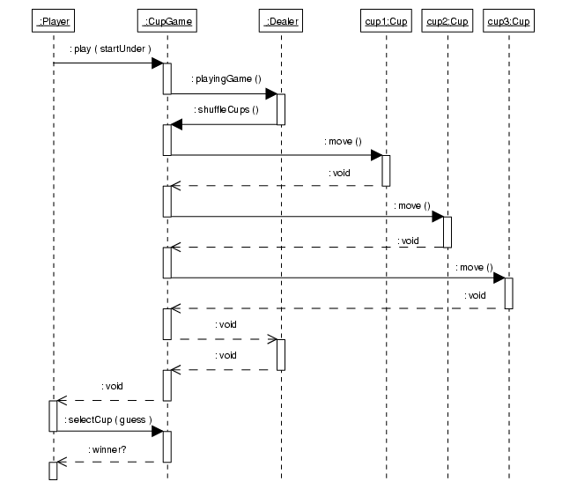
Example –
Step 3: Dynamic Design - Interaction Diagram

Slide 25
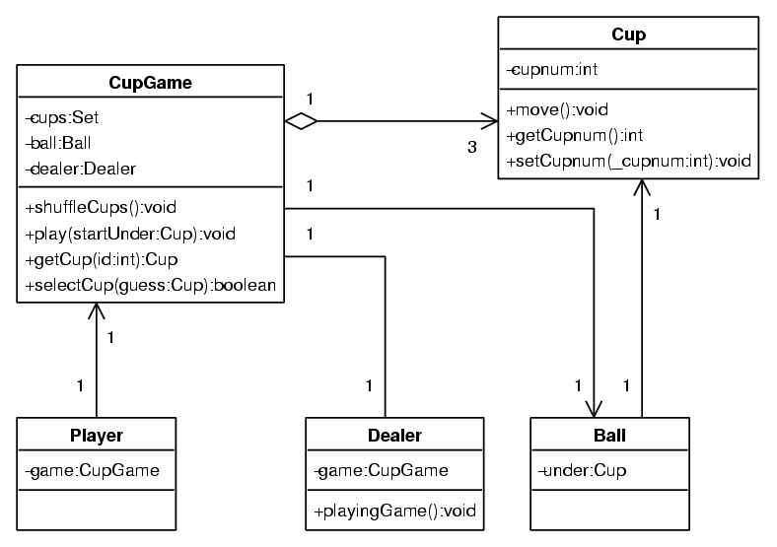
Example - Step 3:
Static Design - Class Diagram

Slide 26
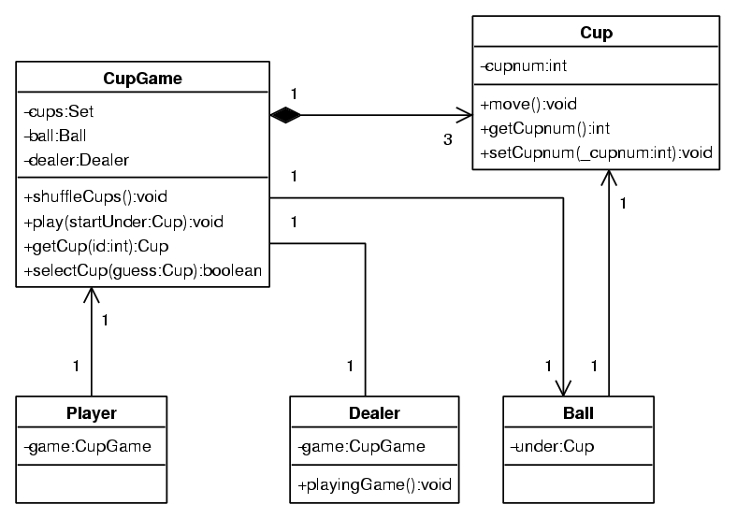
Example - Step 3:
Static Design - Class Diagram

Slide 27
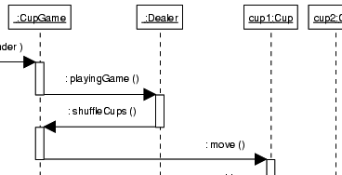
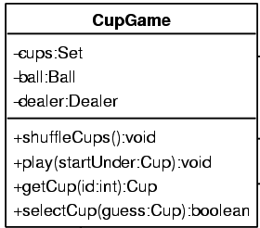
Example - Step 4:
Object-Oriented Program
class CupGame {
private Set cups = new Set();
private Ball ball = new Ball();
private Dealer dealer
= new Dealer();
public CupGame () {
cups.add(new Cup()); // cup1
cups.add(new Cup()); // cup2
…
}
public void shuffleCups () {
Iterator k = cups.iterator();
while ( k.hasNext() ) {
((Cup)k.next()).move();
}
}
…
}

Slide 28
Artifact Influence
Use-Case
Model
Domain
Model
Design Model
(Static and Dynamic Diagrams)
OO Code
(Java, C++, C#)

